Slide 1

SESHADRI RAO
GUDLAVALLERU ENGINEERING COLLEGE
(An Autonomous Institute with Permanent Affiliation to JNTUK, Kakinada)
SESHADRI RAO KNOWLEDGE VILLAGE, GUDLAVALLERU
Department of Electronics and Communication Engineering​
DESIGN OF RHOMBIC MICROSTRIP ANTENNA FOR UWB APPLICATIONS
​
Presentation by:
Batch No.: C17
Mani Ch 18481A04C6
Sai Prathyusha N 18481A04F2
Gopi Raju R 18481A04H6
Naga Pavan Y 18481A04N0
Under the Guidance of:
Dr. Dudla Prabhakar
Associate professor in ECE

Slide 2
Contents
Objectives
Abstract
Implementation steps
Work Progress
References
Software and Hardware Requirements
Methodology Flowchart
Model & Dimensions of the Antenna
Results Obtained

Slide 3
Objectives
To design a microstrip antenna with appreciable gain, bandwidth and other parameters to be operated in microwave frequency.
To achieve desired parameters- return loss, gain, and bandwidth; apply defected ground structure technique.
To use ROGERS 5880 substrate material in order to achieve the one that gives more appreciable results.

Slide 4
Abstract
An efficient design of Rhombus-shaped Microstrip patch antenna with multiple slots and Defected ground structure is proposed for desirable return loss, gain, and bandwidth for operation in Ultra-Wide Band (UWB). In recent times, MPAs are playing an important role as they are found to be immensely compatible in biomedical applications due to their compact nature, easy integration, and lightweight. ROGERS 5880 was chosen as the substrate material for its flexibility and durability. The antenna was simulated using Ansys HFSS (High-Frequency Structure simulator). The merits of using ROGERS 5880 over Graphene were also understood by comparing different parameters. The proposed antenna is also designed to obey the SAR limit of 1.6 W/Kg (Specific absorption rate). Hence, the antenna can be used for on-body communications.

Slide 5
Implementation steps
Antenna requirements
Literature survey and theoretical background
Design via simulation tools
Prototyping
Measurement of parameters
Fabrication of End-product
Documentation

Slide 6
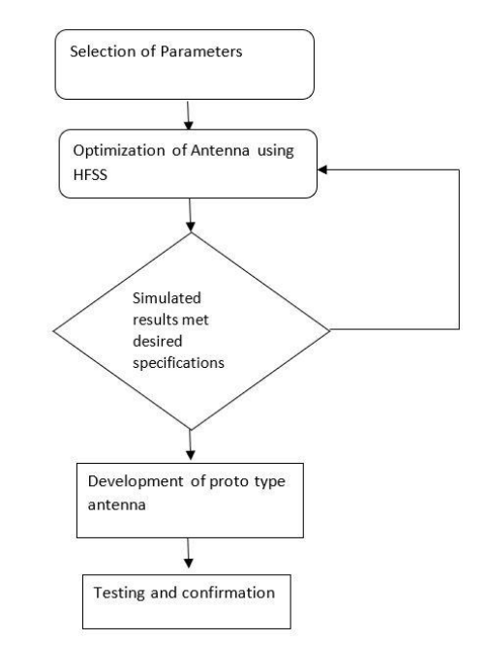
Methodology Flowchart

Slide 7
Software and Hardware required
Ansys HFSS software – for designing the antenna and performing simulation to obtain the gain, bandwidth, VSWR, radiation pattern.
MATLAB - for analyzing different results obtained using various substrate materials.

Slide 8
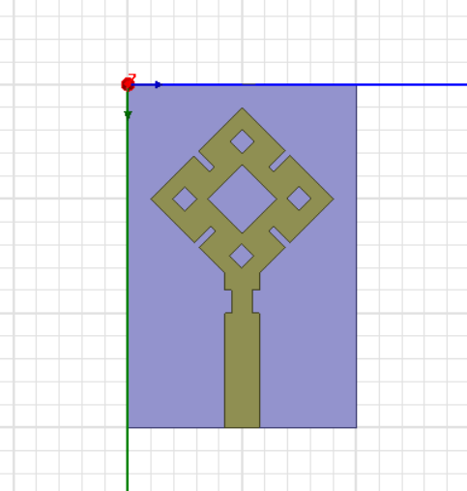
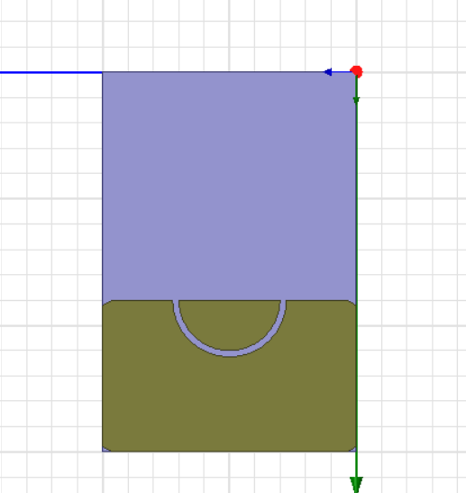
Model of the Antenna
Top and Bottom view of the prototype modeled in HFSS – Patch and Ground

Slide 9
Antenna Dimensions: (in mm)
Length of the substrate 30 | Width of the substrate 20
Width of the slit 0.6 | Length of the slit 2
Length of the feedline 9 | Width of circular ring slot on ground 3.5
Length of corner slots on ground 0.75 | Length & width of smaller slot on patch 1.5
Width of rectangular slot on ground plane 4 | Length & width of patch = 11.31
Width of the feedline 3 | Length & width of inner slot 4.24

Slide 10
Results Obtained
Parameter | Obtained Results
UWB (3.1Ghz-10.6Ghz) | 4.9Ghz-9Ghz
VSWR | <2
Directivity | 9.1428
Reflection Coefficient (S11) in dB | -10.00 dB

Slide 11
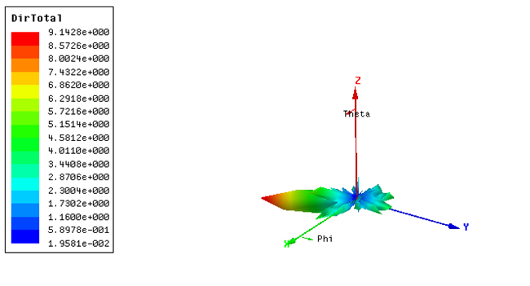
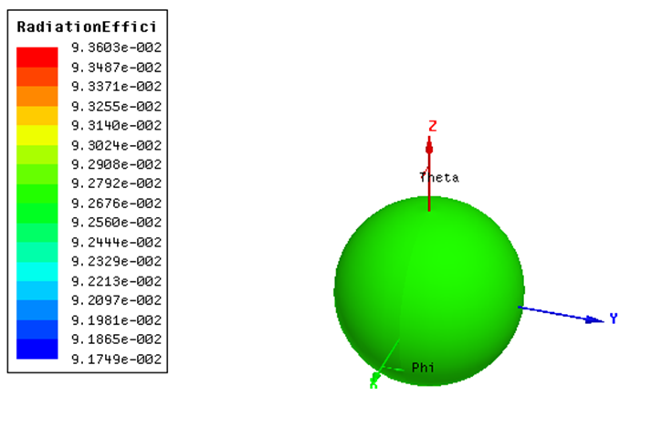
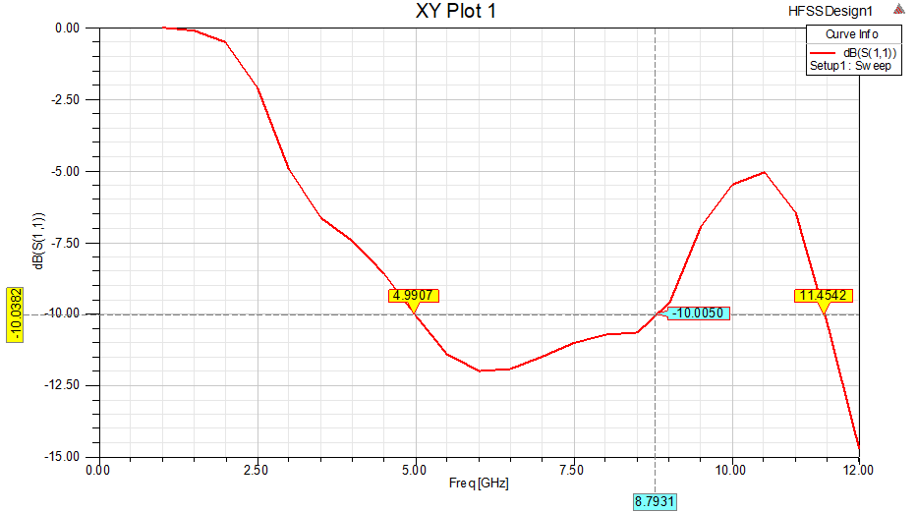
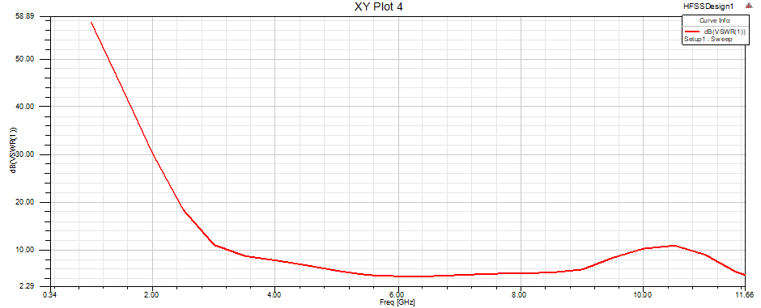
RESULTS OBTAINED

Slide 12
Completed Literature Survey
Completed Software Implementation
Simulated the design
Iterating simulation with different types of the defected ground plane structures
Work Progress

Slide 13
References
1. Liton Chandra Paul, Nahid Sultan, “Design, Simulation and Performance Analysis of a Line Feed Rectangular Micro-Strip Patch Antenna”, International Journal of Engineering Sciences & Emerging Technologies, Volume 4, Issue 2, February 2013, ISSN: 2231-6804.
2. R. K. Tanti, S. Warathe and N. Anvesh Kumar, "Design of a Circular Planar UWB Antenna and its Higher Cut-off Frequency Enhancement," 2019 10th International Conference on Computing, Communication and Networking Technologies (ICCCNT),2019,pp.1-6, DOI:10.1109/ICCCNT45670.2019.8944570.
3. K. N. Paracha et al., "A Low Profile, Dual-band, Dual Polarized Antenna for Indoor/Outdoor Wearable Application," in IEEE Access, vol. 7, pp. 33277-33288, 2019, DOI:10.1109/ACCESS.2019.2894330.

Slide 14


